Slide 1
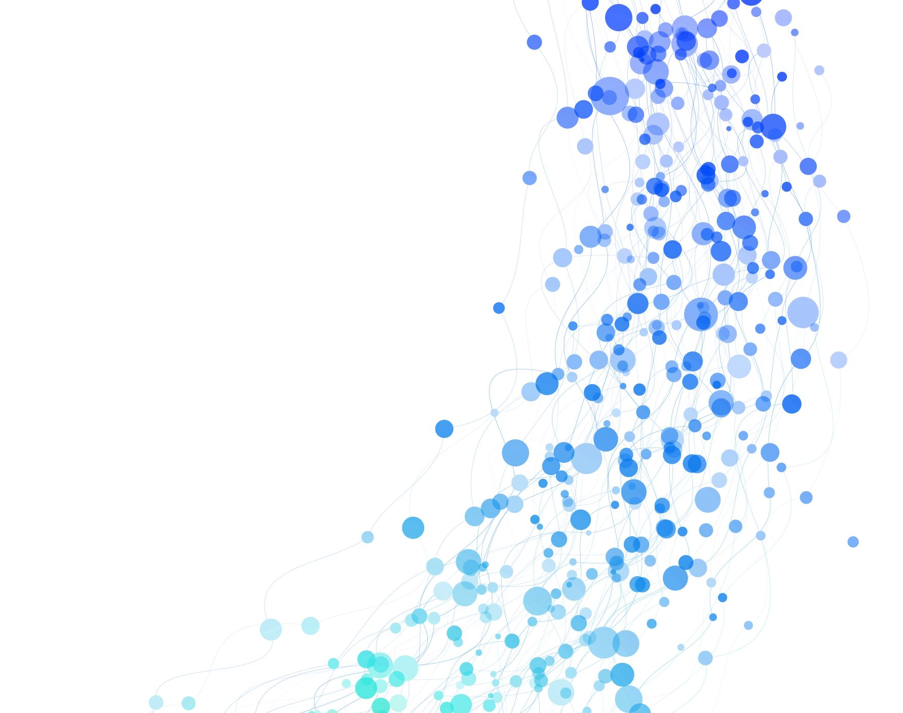
Network Quality Analysis for Microsoft Teams Calls
Final Project Presentation Presented by:
Asaf Galili -315785006
Tal Sahar- 206955452

Slide 2
Introduction
Overview
Overview of the project’s objective to assess the quality of Microsoft Teams calls.
Focus on
Focus on three key network quality metrics: Latency, Jitter, and Bitrate.
Project
Project Goal:
To provide insights on how these metrics impact call quality and user experience, and to automate the measurement process for reliable analysis.

Slide 3
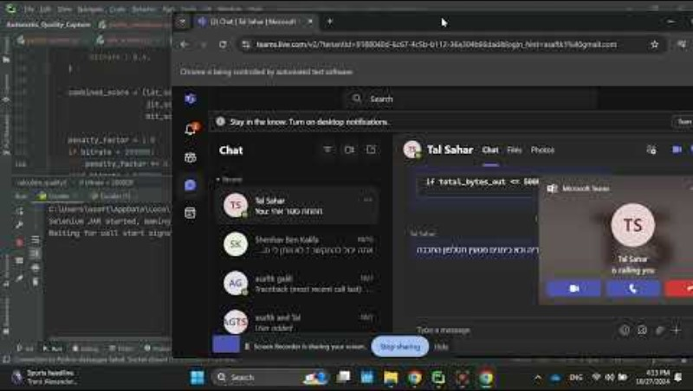
Running example:

Slide 4
Research on Network Quality
Summary:
Studies on real-time communication underscore the critical role of stable network metrics, especially for latency, jitter, and bitrate.
Key Findings:
Latency: Above 150ms can cause conversational lag.
Jitter: Over 20ms disrupts video/audio continuity.
Bitrate: A bitrate below 1 Mbps can lead to poor resolution and pixelation, especially for video calls. Higher bitrates (1.5-2 Mbps or more) generally correspond to better video and audio quality, helping to maintain clarity and reduce compression artifacts.

Slide 5
Dataset Overview:
The dataset consists of multiple PCAP recordings of Microsoft Teams conversations, each representing different quality levels.
Each recording includes simulated network issues, such as latency and packet loss, introduced using Clumsy (a network simulation tool).

Slide 6
Quality Assessment Process
For each conversation, the quality was manually assessed based on visual and audio clarity.
Recordings were segmented based on quality levels observed, allowing for labeled sections of “Good,” “Fair,” and “Poor” quality.
Segmented PCAP files provide focused data samples, which are essential for training and testing the quality assessment model.

Slide 7
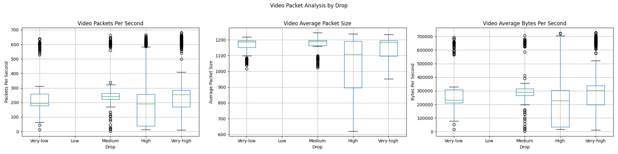
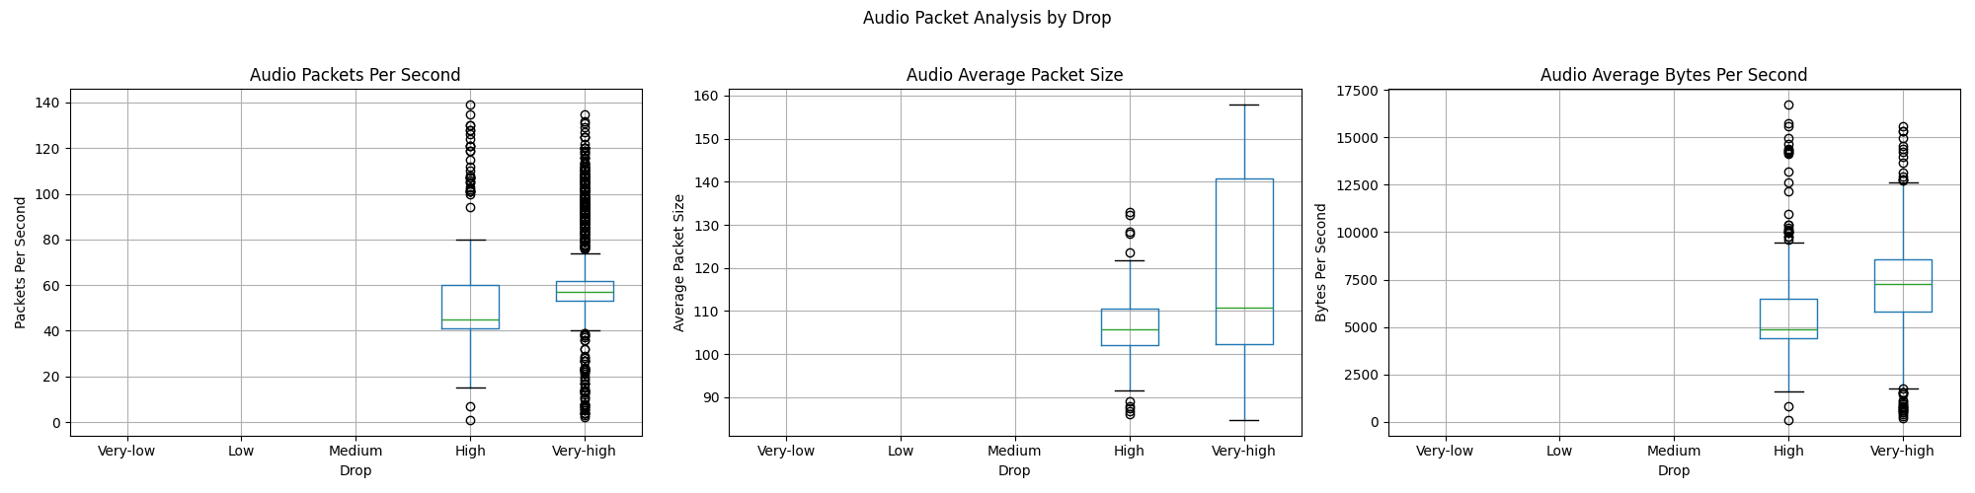
BoxPlots

Slide 8
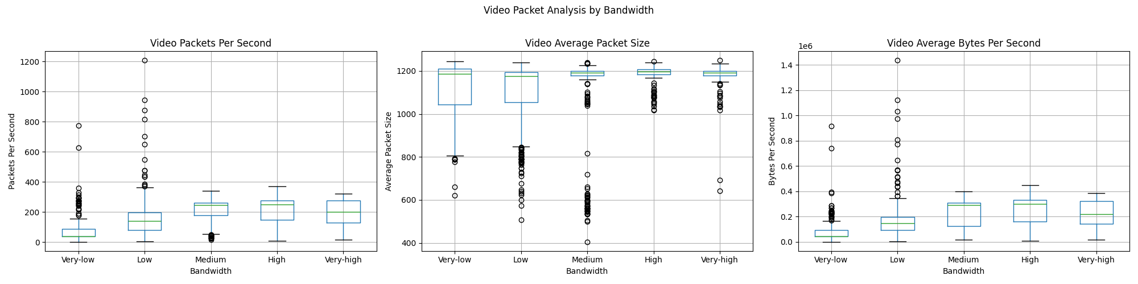
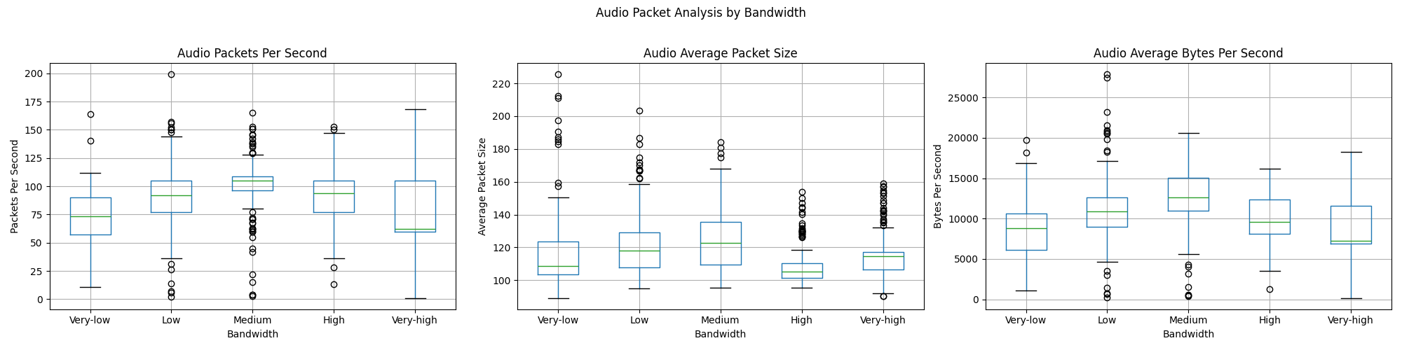

Slide 9
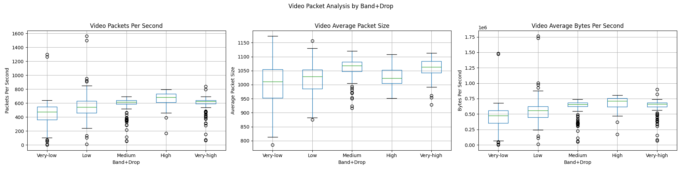
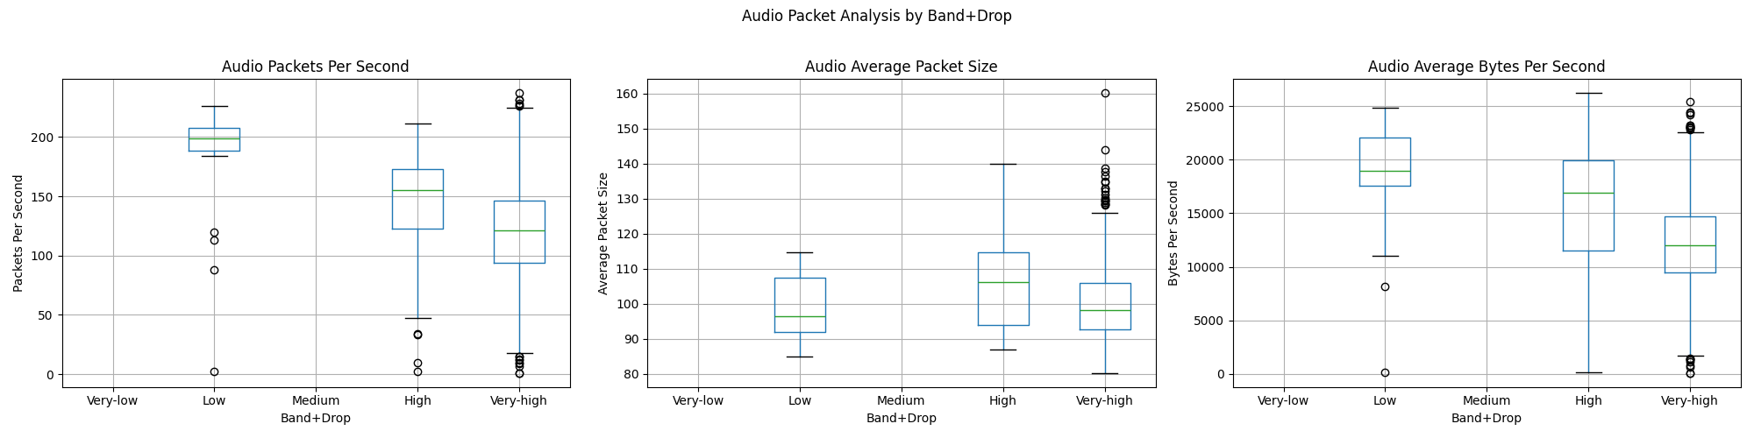

Slide 10
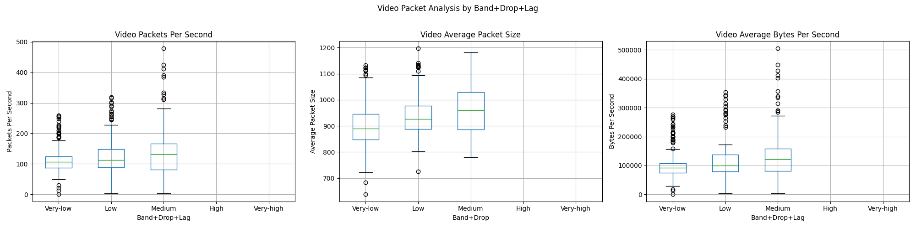
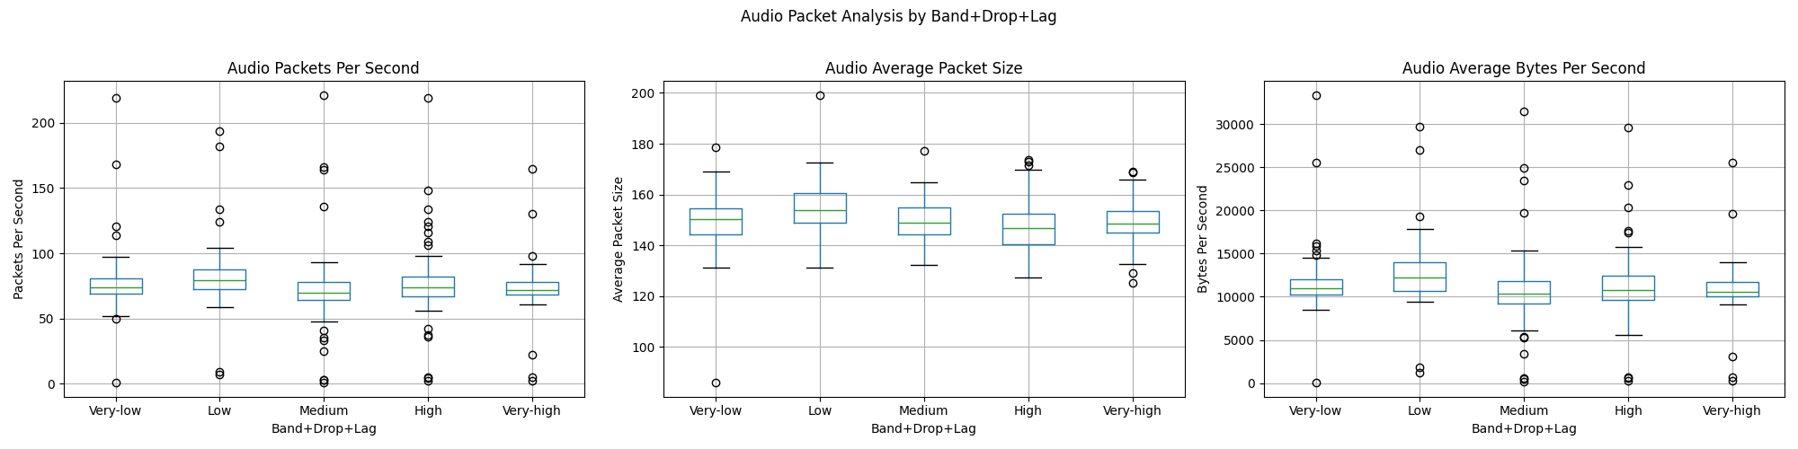

Slide 11
Summary of Network Condition Effects on Video and Audio Metrics
Video Packet Analysis :
Drop Conditions: Increased drop rates lead to unstable video packets per second and a notable decrease in bytes per second, indicating degraded video quality. Video quality is highly sensitive to packet drops, necessitating stringent monitoring of drop rates to maintain stable video transmission.
Bandwidth Constraints: Lower bandwidth levels significantly impact video transmission, resulting in reduced packet rates and bytes per second. Variability in packet size suggests adaptations like compression under limited bandwidth. Thus, bandwidth serves as a primary determinant for video quality.
Combined Conditions (Bandwidth + Drop + Lag): Under simultaneous adverse conditions, video packets per second and bytes per second show sharp declines, revealing compounded degradation. This underlines the need for a multi-metric approach, as combined conditions exacerbate video quality issues.
Audio Packet Analysis:
Drop Conditions: Audio packet rates are minimally affected by drops, showing higher resilience compared to video. Bytes per second show only slight reductions, suggesting that audio can withstand higher drop rates without drastic quality loss.
Bandwidth Constraints: Audio quality remains stable under varying bandwidths, underscoring its lower bandwidth dependency. Bytes per second only slightly decrease under limited bandwidth, demonstrating that audio is less impacted by network constraints than video.
Combined Conditions: Audio shows greater stability in packet rate and bytes per second under combined adverse conditions compared to video. This resilience supports a model where audio thresholds are less stringent than video, as audio degrades more gradually.
Overall Model Insights: These findings reinforce the need for distinct thresholds for audio and video within the quality assessment model. The model prioritizes bandwidth monitoring for video and incorporates a multi-metric approach to handle compounded conditions affecting video quality more than audio. By leveraging these structured insights, the model can provide accurate, real-time quality assessments for different network conditions, particularly in Microsoft Teams calls.

Slide 12
Proposed Method
The project approach is to assess the quality of Microsoft Teams calls by capturing and analyzing network metrics in real-time
The primary steps include:
Packet Capture with Tshark
Automated Call Initiation with Selenium
Data Analysis and Visualization in Python
This approach allows for continuous quality monitoring and provides immediate insights into the network’s impact on call performance.

Slide 13
Packet Capture Setup
Sets up real-time packet capture for UDP and TCP packets using Tshark.
The startTshark function captures packets on the selected network interface, while parse_line function extracts key details like IP addresses, ports, and packet size.
Parsing Packet Data
Details Extracted: Source and destination IPs, ports, packet size, and arrival time.
Purpose: To break down packet information for use in calculating network metrics and identifying relevant streams for quality analysis
Largest Streams Detection
Role: Determines the largest incoming and outgoing streams by packet count, helping focus analysis on the main call streams.
Use Case: Identifies the IP pairs with the most traffic, ensuring that only relevant data is included in quality calculations. In case of low Bitrate (below some threshold) the detection process repeats itself.

Slide 14
Selenium Automation Overview
Tool:
TeamsSelenium.jar
Function:
Automates the initiation of Microsoft Teams calls, reducing the need for manual control.
Purpose:
Allows consistent, repeatable call tests, ensuring data is captured under controlled conditions.

Slide 15
Benefits of Automation
Reliability: Automation ensures consistent testing, which is essential for accurate quality analysis.
Efficiency: Reduces human intervention, allowing multiple tests to be performed quickly and consistently.

Slide 16
Visualization - Real-Time GUI
Features:
The GUI uses Tkinter to provide a real-time display of network metrics (latency, jitter, bitrate).
Purpose:
Enables continuous monitoring, with visual indicators of the video-chat incoming and outgoing streams and their metrics.

Slide 17

Network Quality Metrics
Latency:
Measures delay in packet transmission. High latency causes delays, making conversations feel unnatural.
Jitter:
Measures variability in packet arrival times. High jitter can disrupt audio/video synchronization.
Bitrate:
Measures the data transfer rate. A higher bitrate often correlates with clearer, higher-quality audio and video

Slide 18
Latency Explained
Definition: Latency refers to the delay that happens between when a user takes an action on a network or web application and when it reaches its destination.
Effect: High latency results in noticeable delays between speakers, causing communication to feel fragmented.
Target: Ideal latency for video calls is typically below 75ms. Latency above 150ms can negatively impact user experience.

Slide 19
Jitter Explained
Definition: Jitter is the variation in packet arrival times.
Effect: High jitter can lead to disrupted audio and video, causing choppy or inconsistent playback.
Target: Maintaining jitter below 20ms helps preserve smooth, high-quality communication.

Slide 20
Bitrate Explained
Definition: Bitrate is the rate at which data is transmitted over a network, measured in bits per second (bps).
Effect: Higher bitrates provide clearer audio and video quality, while low bitrates can lead to poor resolution and compression artifacts.
Target: A higher bitrate (typically above 2 Mbps) enhances call clarity and stability

Slide 21
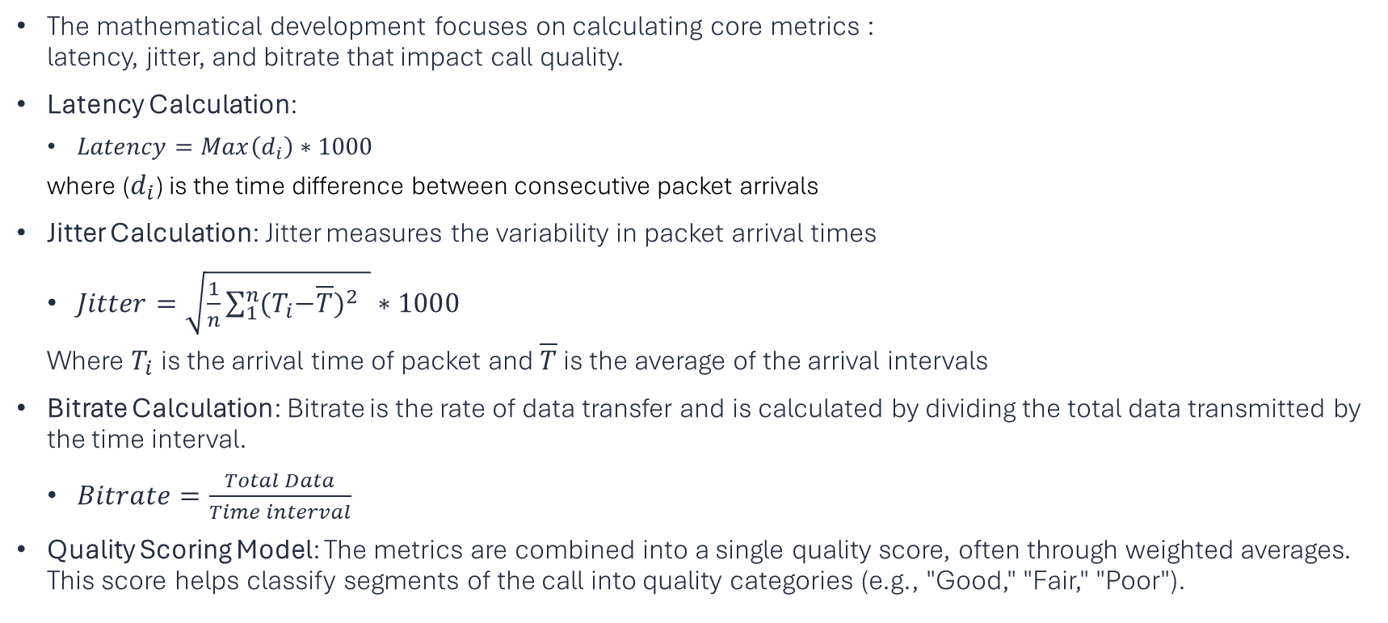
Mathematical Development
The mathematical development focuses on calculating core metrics : latency, jitter, and bitrate that impact call quality.
Latency Calculation:
$Latency=Max\left(d_{i}\right)∗1000$
where ($d_{i}$) is the time difference between consecutive packet arrivals
Jitter Calculation: Jitter measures the variability in packet arrival times
$Jitter=\sqrt{\frac{1}{n}\sum_{1}^{n}{{{(T}_{i}−\overline{T})}^{2} } }∗1000$
Where $T_{i}$is the arrival time of packet and $\overline{T}$ is the average of the arrival intervals
Bitrate Calculation: Bitrate is the rate of data transfer and is calculated by dividing the total data transmitted by the time interval.
$Bitrate=\frac{Total Data}{Time interval}$
Quality Scoring Model: The metrics are combined into a single quality score, often through weighted averages. This score helps classify segments of the call into quality categories (e.g., "Good," "Fair," "Poor").

Slide 22
Quality Calculation Algorithm
Key Metrics: Calculates Latency, Jitter, and Bitrate.
Process: These metrics are used to compute a quality score (1-10), representing the overall video chat stream during the call.
In quality_calculations.py , each packet’s data is analyzed to compute latency, jitter, and bitrate.
These metrics are evaluated continuously and assigned individual scores based on thresholds to assess call quality.
Based on the computed metrics, each segment is categorized as "Good," "Fair," or "Poor." For instance:
Good Quality: Low latency (<75ms), low jitter (<20ms), and high bitrate (>1.5 Mbps).
Fair Quality: Moderate values in any metric.
Poor Quality: High latency or jitter, or low bitrate.
This algorithm ensures a comprehensive assessment of call quality, enabling users to monitor and identify network issues affecting Microsoft Teams call performance.

Slide 23
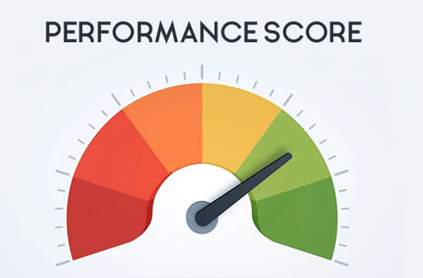
Scoring
Latency Score: Calculated based on latency thresholds (1-10). Lower latency mean better performance, as low latency enhances responsiveness in real-time communication. Penalties are applied when latency exceeds certain thresholds (e.g., 50 ms or 200 ms), reducing the score to reflect potential delays.
Jitter Score: Also ranges from 1-10, with higher scores for low jitter. Stable packet arrival times (low jitter) lead to a smoother experience. Penalties are triggered when jitter exceeds specific levels, such as 10 ms or 25 ms, lowering the score to capture potential disruptions in playback.
Bitrate Score: Calculated based on the average bitrate. Scores above 9 are given for bitrates above 2 Mbps, where higher bitrate scores indicate clearer audio/video quality. A penalty is applied for bitrates below 500 kbps, as lower bitrates can result in poor resolution or compression artifacts.
Effect on Quality: Higher bitrate scores indicate clearer audio/video quality, while lower scores suggest issues like low resolution or compression artifacts.
Purpose: These scores directly affect the quality assessment, with higher scores indicating stable network conditions. Penalty factors dynamically adjust scores based on threshold breaches, ensuring that quality reflects real-time network fluctuations.

Slide 24
Data Visualization
Function:
Plots call metrics over time, including Latency, Jitter, and Bitrate.
Purpose:
Provides clear visual insights, helping identify trends, peaks, and stability during the call.

Slide 25
Project Results
The objective metrics (latency, jitter, bitrate) showed a strong correlation with subjective quality ratings. Segments with low latency, low jitter, and high bitrate consistently aligned with "Good" quality, while those with higher latency, higher jitter, and lower bitrate were rated “Poor.”
This correlation suggests that the calculated metrics are reliable indicators of call quality and could be used in real-time monitoring to flag potential issues.

Slide 26
Conclusion
This project successfully demonstrated a method for assessing Microsoft Teams call quality in real-time through the capture and analysis of key network metrics: latency, jitter, and bitrate. By establishing clear thresholds for these metrics, we were able to effectively classify call quality levels as Good, Fair, or Poor. Through packet capture and segmentation, we established thresholds for these metrics to reliably classify call quality as Good, Fair, or Poor.
Simulated network disruptions (using Clumsy) provided a controlled environment for testing, validating the model’s responsiveness to varying network conditions.
Ultimately, the project confirmed the viability of a metrics-based monitoring approach for Teams calls, offering a practical tool for real-time quality assessment that can support proactive management of network conditions in communication applications.

Slide 27
Future Improvements
Extended Testing on Various Platforms: Expand testing to include different video conferencing platforms like Zoom and Google Meet. This cross-platform testing could validate the versatility of the quality assessment model and allow for adaptations based on platform-specific network behaviors.
Machine Learning for Quality Prediction: Use machine learning to analyze patterns in network metrics over time and predict potential quality drops. Such a model could proactively alert users or adjust network settings to prevent quality degradation.

Slide 28
Research References
Mavlankar, A., & Girod, B. (2008). Video Quality Assessment and Comparative Evaluation of Peer-to-Peer Video Streaming Systems. IEEE International Conference on Multimedia and Expo (ICME), 2008. This article provides foundational insights into how video quality metrics like PSNR (Peak Signal-to-Noise Ratio) are used in evaluating streaming quality, particularly under varying network conditions.
Moorthy, A. K., & Bovik, A. C. (2012). Video Quality Assessment on Mobile Devices: Subjective, Behavioral, and Objective Studies. IEEE Journal of Selected Topics in Signal Processing, 6(6), 652-671. This work discusses the importance of temporal pooling in video quality assessment and how models must handle dynamic quality variations, which supports the penalty application approach in our algorithm.
Yang, F., Ong, E. P., & Raake, A. (2010). No-Reference Quality Assessment for Networked Video via Primary Analysis of Bitstream. IEEE Transactions on Circuits and Systems for Video Technology, 20(11), 1544-1555. This article provides background on no-reference (NR) quality assessment and highlights the effectiveness of bitstream analysis for real-time video quality assessment, aligning with our approach of assessing network metrics like jitter and latency.
Schmitt, M., et al. (2016). 1 Mbps is Enough: Video Quality and Individual Idiosyncrasies in Multiparty HD Video-Conferencing. IEEE Quality of Multimedia Experience (QoMEX), 2016. This study validates the bitrate threshold applied in our algorithm, highlighting that 1 Mbps bitrate is sufficient to satisfy user experience in multiparty video conferencing, with diminishing returns at higher bitrates.
Rao, A., et al. (2011). Network Characteristics of Video Streaming Traffic. arXiv preprint arXiv:1111.0948. This paper discusses the effects of network characteristics, particularly jitter and latency, on video quality. The insights support the decision to apply penalties based on threshold breaches in these metrics for a more accurate quality assessment.
6. Microsoft. (n.d.). Monitor call and meeting quality in Microsoft Teams. Retrieved October 26, 2024, from https://support.microsoft.com/en-us/office/monitor-call-and-meeting-quality-in-microsoft-teams-7bb1747c-d91a-4fbb-84f6-ad3f48e73511
7. Telehealth Training. (n.d.). Your Guide to What Affects Video Call Quality. Retrieved October 26, 2024, from https://telehealth.training/articles/Your-Guide-to-What-Affects-Video-Call-Quality

